Slide 1

REAL ESTATE
Sprint 1&2

Slide 2
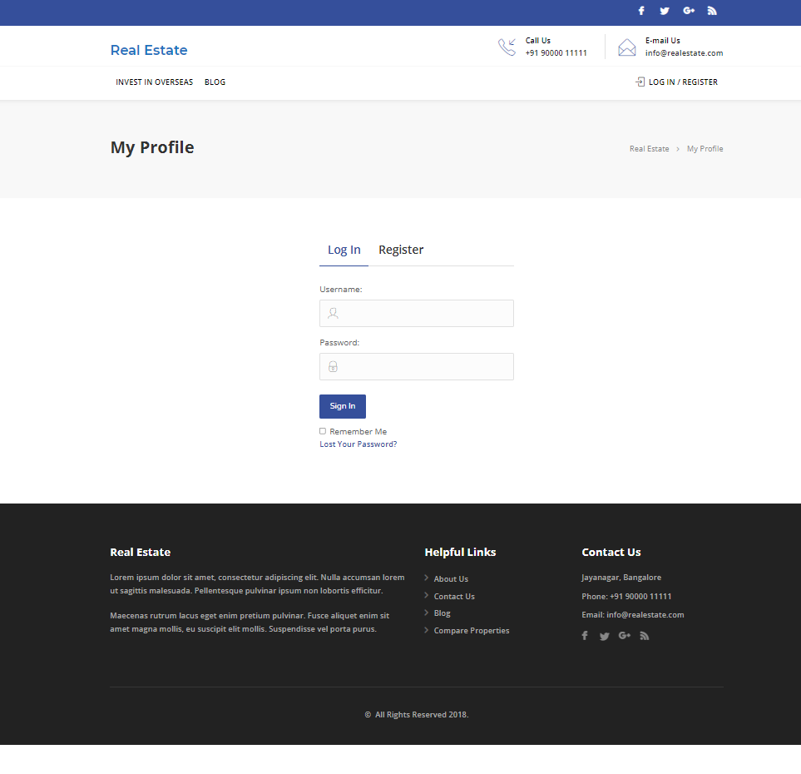
Real Estate website
Welcome to Real Estate

Slide 3

Roles
Scrum master- Sreelakshmi Ram A
Team members-
Srishti Ghosh
Supriya Barthwal
Varshitha N
Swathi M
Swagata Malik
Soumya Shet
Sushmitha S
Taznaine

Slide 4
FEATURES
Admin
Login
Profile
Dashboard
Comments
user-all, new, profile
Post-all post
Media-library, add new
property-add new
User
Register/Login
Homepage
Profile
Property management-contact form
Search property
Bookmark
For enquires
Change password

Slide 5
Manual testing - sprint 1
Activities
Planning-User stories in Jira
Work allocation- For test design to team members- Jira tasks
Test design process-
Scenarios- categorised based on business risks
Test cases
Pre-conditions and specification for data creation
Test design techniques applied where ever necessary
Review process and baseline of testcases

Slide 6
Jira – Workflow in Sprint 1
15 Stories were created in Jira with respect to Admin side and user side
No of tasks & sub-tasks-16
No of bugs - 23
Review of each task was completed.
Execution of the testcase was submitted.
Defects were logged into the defect log with 23 defects.
Issue log was created with 41 issues.

Slide 7
Sprint 1
All post, add new post, delete post, add category and tag functionalities was assigned by scrum master.
Stories and task for all post, add new post, delete post, add category and tag was created in Jira.
Test cases for all post, add new post, delete post, add category and tag was created in excel.
Test cases were reviewed and executed.
Defects and issues which were found during the execution of test cases and were noted down.
Bugs were created in Jira.

Slide 8
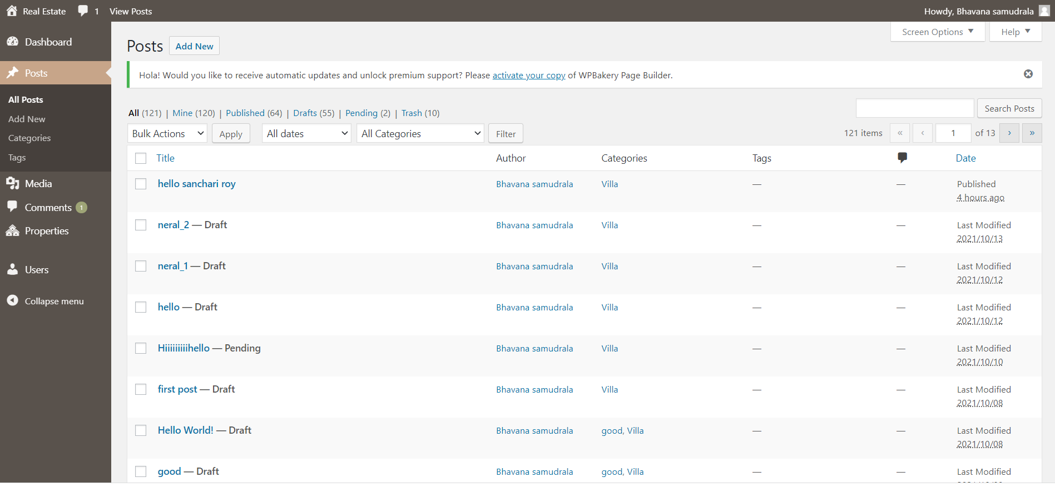
Real Estate website
Functionalities:
All post
Add new post Delete post
Add category Add tag

Slide 9
Test execution
Preparation of test data
Smoke test including pre-condition check
Start of Test execution
Defect logging if any –2 cycles
Follow ups
Bug allocation to development team
Updating of issue log

Slide 10
Test Metrics
Module wise number Of test cases written-100
Defect age
Category wise defect analysis based on priority, severity, status -41
Review of each task and submission of checklist.
Execution of the testcase was submitted.

Slide 11
Post execution activities
Like to have features in application communicated to developers.
Ongoing issues discussed during the pre-production move of release 1.
Review of acceptance criteria.
Planning for regression test cases using manual/automation approach.

Slide 12
Automation testing - Sprint 2
Planning activities-selection of test cases for automation under
Smoke test
Sanity test
Regression test
Task allocation for automation test cases to automation testers
Techniques followed - Selenium , Java ,Maven, TestNG, Page Object Model, frameworks selected for the automation

Slide 13
Jira – Workflow in Sprint 2
15 Stories were created in Jira with respect to Admin side and user side
Sprint 1 -
No of tasks & sub-tasks-22
No of bugs – 13
Each task went through different automation testing which was segregated with respect to severity.
Defects were logged into the defect log with 13 defects.
Issue log was created with 13 issues.

Slide 14
Sprint 2
Admin
1. Sanity Test - All post
2. Sanity Test - Add new post
3. Sanity Test - Delete post
4. Sanity Test - Add new category
5. Sanity Test - Add new tag
Automation of addition, deletion and editing of the post is done using eclipse.
Selenium , Java ,Maven, TestNG, Page Object Model, frameworks selected for the automation.
Screenshots of non-functional commands were taken and defects were noted down.
TestNG reports were generated.

Slide 15
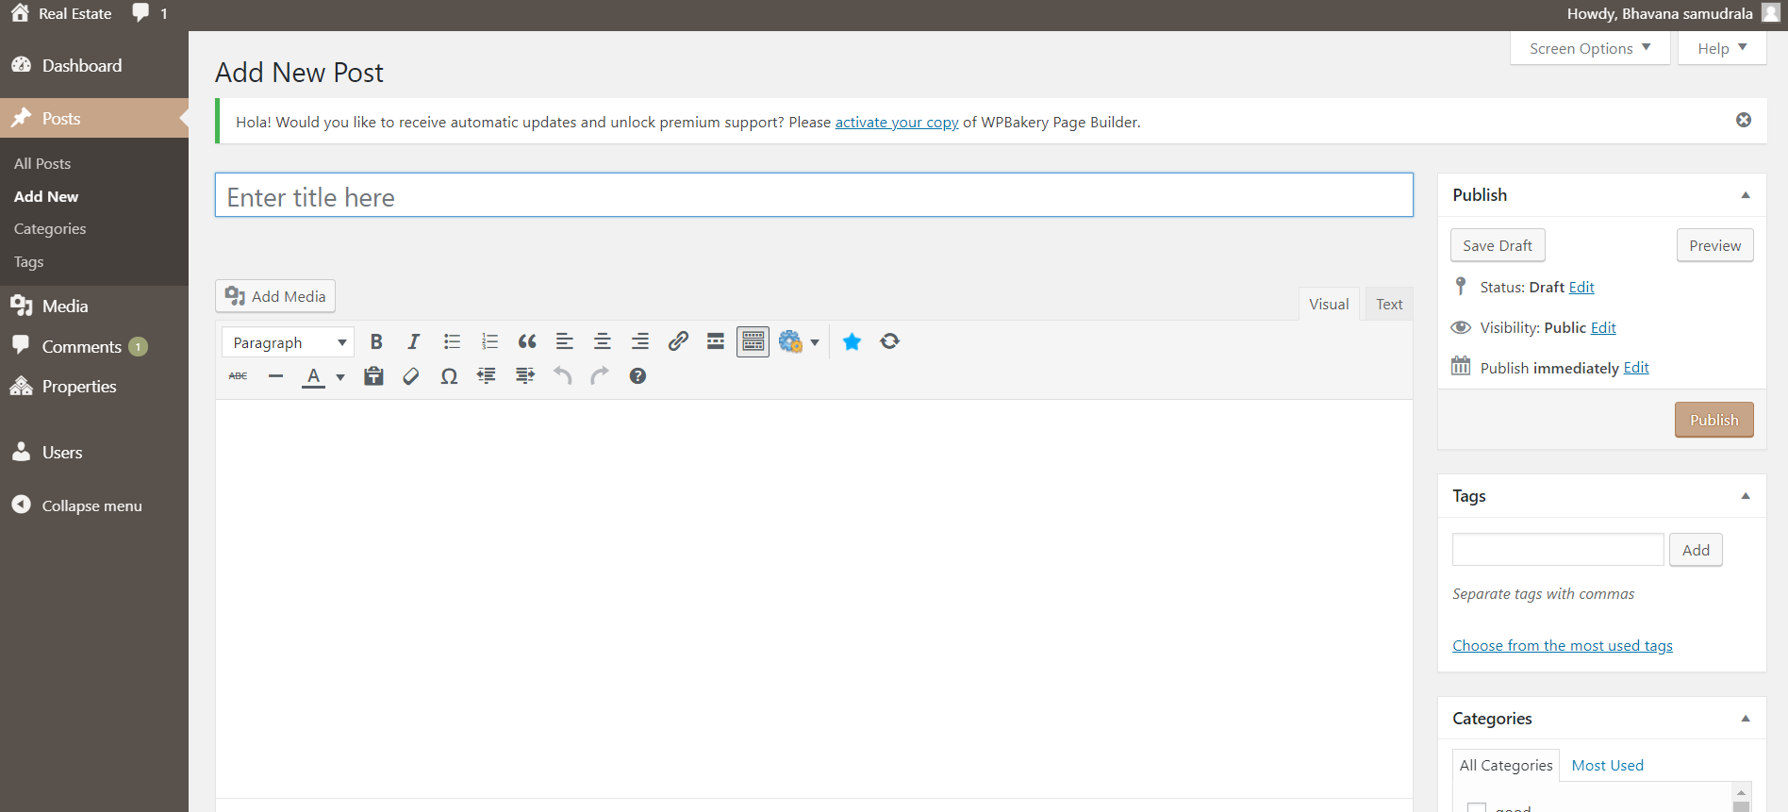
Real Estate website
Functionalities for Automation:
All post
Add new post
Delete post
Add category
Add tag

Slide 16
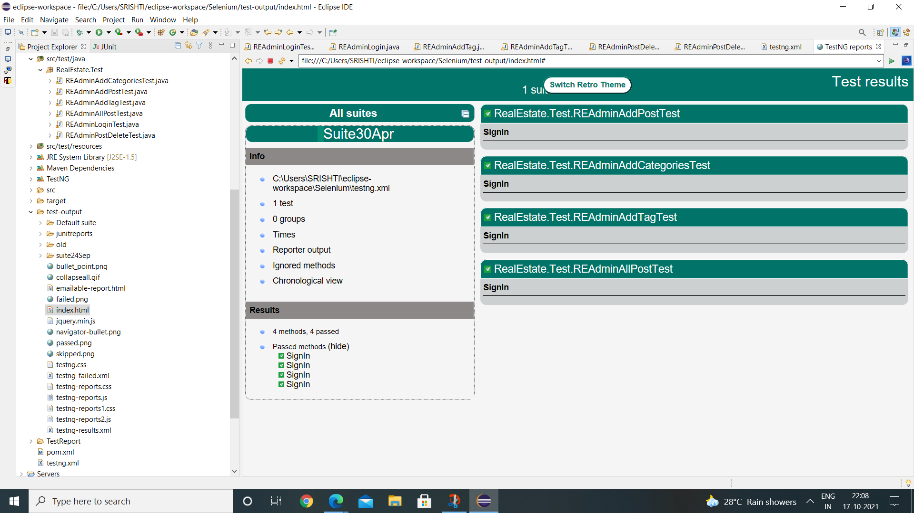
TestNG Report

Slide 17
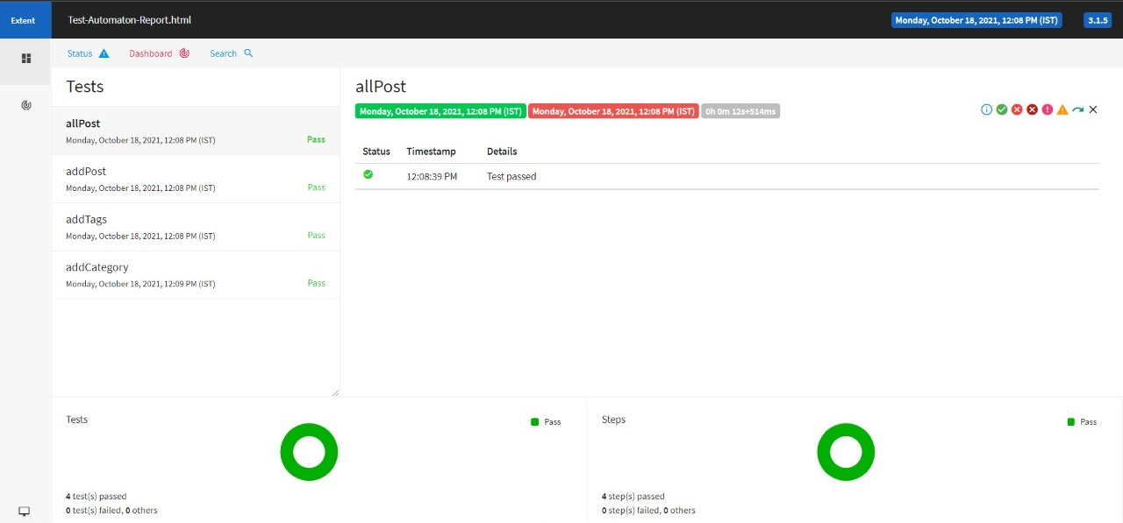
Extent Report

Slide 18
THANK YOU

